Slide 1
Control Systems
Mathematical models – Differential equations
Translational and Rotational mechanical systems

Slide 2
Objectives
In this lecture, we lead you through a study of mathematical models of physical systems.
After completing the topic you should be able to
Describe a physical system in terms of differential equations.
Understand the way these equations are obtained.
Realize the use of physical laws governing a particular system such as
Newton’s law for mechanical systems and Kirchhoff’s laws for electrical systems.
Realize that deriving mathematical models is the most important part of the entire analysis of control systems.
2

Slide 3
Mathematical Model
Mathematical modeling of any control system is the first and foremost task that a control engineer has to accomplish for design and analysis of any control engineering problem.
A mathematical model of a dynamic system is defined as a set of differential equations that represents the dynamics of the system accurately, or at least fairly well.
Note that a mathematical model is not unique to a given system. A system may be represented in many different ways and, therefore, may have many mathematical models, depending on one’s perspective. For example,
In optimal control problems, it is good to use state-space representations.
On the other hand, for the transient-response or frequency-response analysis of single- input-single-output, linear, time-invariant systems, the transfer function representation may be more convenient than any other.
3

Slide 4
Mathematical Model
Once a mathematical model of a system is obtained, various analytical and computational techniques may be used for analysis and synthesis purposes. Because the systems under consideration are dynamic in nature, the equations are usually differential equations. If these equations can be linearized, then the Laplace transform may be utilized to simplify the method of solution.
3

Slide 5
Types of Mathematical Models
Differential equation model
Dynamics of the system represented in terms of differential equations
Time domain representation of the system
Transfer function model
Dynamics represented in terms of a Laplace
transform expression
Frequency domain representation of the system
State space model
State is a set of variables that describes the system behaviourin conjunction with the system inputs
Dynamics are represented by a set of first order
differential equations using these state variables

Slide 6
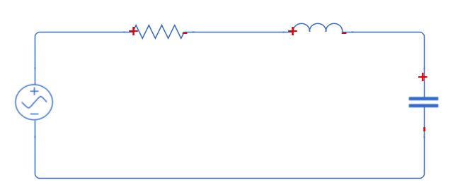
Types of Mathematical Models
𝐼 𝑅
𝐿
Differential equation model
Dyna differe
Time d
𝑉_{𝑅}
𝑉_{𝐿}
mics of the system represented in terms of
ntial equations
omain representation of the system
𝑉
𝑉_{𝐶}
𝐶
Transfer function model
Dynamics represente_{𝑑}d_{𝑉}in term_{𝑑}s_{𝐼} of a L_{𝑑}a2p_{𝐼}lace_{𝐼}
transform expression = 𝑅 + 𝐿 ₂ +
𝑑𝑡 𝑑𝑡 𝑑𝑡 𝐶
Frequency domain representation of the system
𝐼(𝑠) 1
=
𝑉(𝑠)
1
State space model
State is a set of variables that 𝑅de+sc𝐿ri𝑠be+s t_{𝐶}h_{𝑠}e system
behaviourin conjunct𝑑io𝐼_{𝐿}n with the𝑅sys1tem inputs
1
𝐿 0
Dynamics represented_{𝑑}b_{𝑡}y a set⁻of_{𝐿}first_{𝐿}ord𝐼_{𝐿}er
differential equations_{𝑑}u_{𝑉}s_{𝐶}ing⁼state₁variable_{𝑉}s_{𝐶}
+
𝑉
0
𝑑𝑡 𝐶
5

Slide 7
Different Mathematical Models
Commonly used mathematical models are
Differential equation model (Time Domain).
Transfer function model (S-Domain).
State space model (Time Domain).
Use of the models depends on the application. For example, to find the transient or steady state response of SISO (Single Input Single Output) LTI (Linear Time Invariant) system transfer function model is useful.
On the other hand for optimal control application state space model is useful.

Slide 8
The approach to dynamic system problems can be as follows:
Define the system and its components.
Formulate the mathematical model and list the necessary assumptions
Write the differential equations describing the model.
Solve the equations for the desired output variables.
Examine the solution and the assumptions.
If necessary reanalyze or redesign the system.

Slide 9
TRANSFER FUNCTION
Transfer functions are commonly used to characterize the input—output relationships of components or systems that can be described by linear, time-invariant, differential equations.
The transfer function of a linear, time-invariant, differential equation system is defined as “the ratio of the Laplace transform of the output (response function) to the Laplace transform of the input (driving function) under the assumption that all initial conditions are zero”.
❑

Slide 10
Physical Systems
Physical systems can be classified into various types:
Electrical systems/Electronic systems
Mechanical systems
Hydraulic systems
Thermal systems
Each of these systems can be modelled in terms of certain basic
elements
Basic elements of all physical systems can be shown to be analogous
10

Slide 11
Electrical Systems
Based on the type of source, electrical systems can be classified as:
Voltage sourced systems
Current sourced systems
Voltage sourced | Current sourced
Basic System Elements
Resistor (𝑅) | Resistor (𝑅)
Inductor (𝐿) | Inductor (𝐿)
Capacitor (𝐶) | Capacitor (𝐶)
Basic System Variables
Voltage (𝑉) | Current (𝐼)
Charge (𝑄) | Flux (𝜙)
11

Slide 12



Electrical System Elements
Resistor (𝑅): It is an element which resists the flow of current in an
electrical system
𝑉 = 𝐼𝑅
𝑅
Inductor (𝐿): It is an element that stores electrical energy in a magnetic field
𝑑𝜙 𝑑𝐼
𝑉 = _{𝑑𝑡} = 𝐿 _{𝑑𝑡}
𝐿
Capacitor (𝐶): It is an element that stores electrical energy in a electrical field
𝑑𝑞 𝑑𝑉
𝐼 = _{𝑑𝑡} = 𝐶 _{𝑑𝑡}
𝐶
:
5

Slide 13
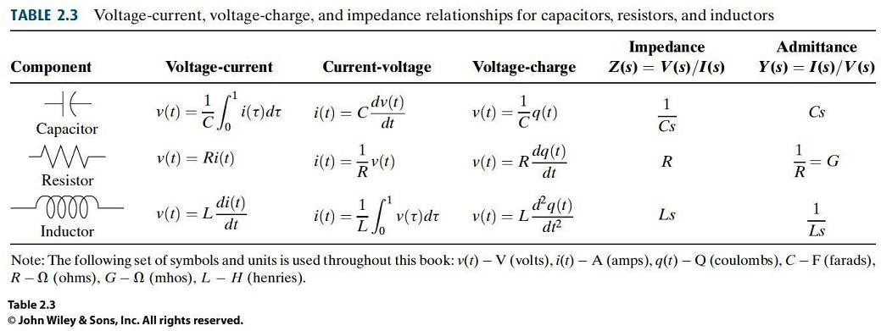

Describing Differential Equations for Electrical and Electronic Elements

Slide 14

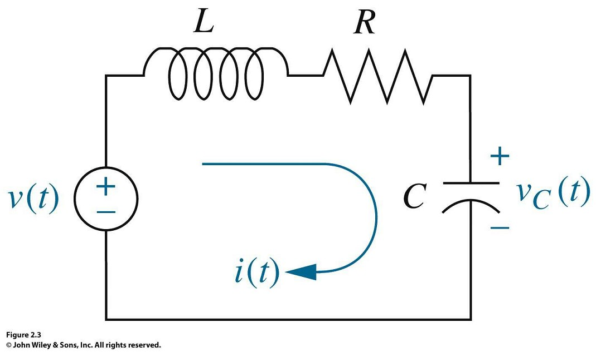

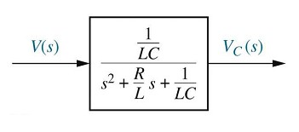
Electrical Circuits

Slide 15
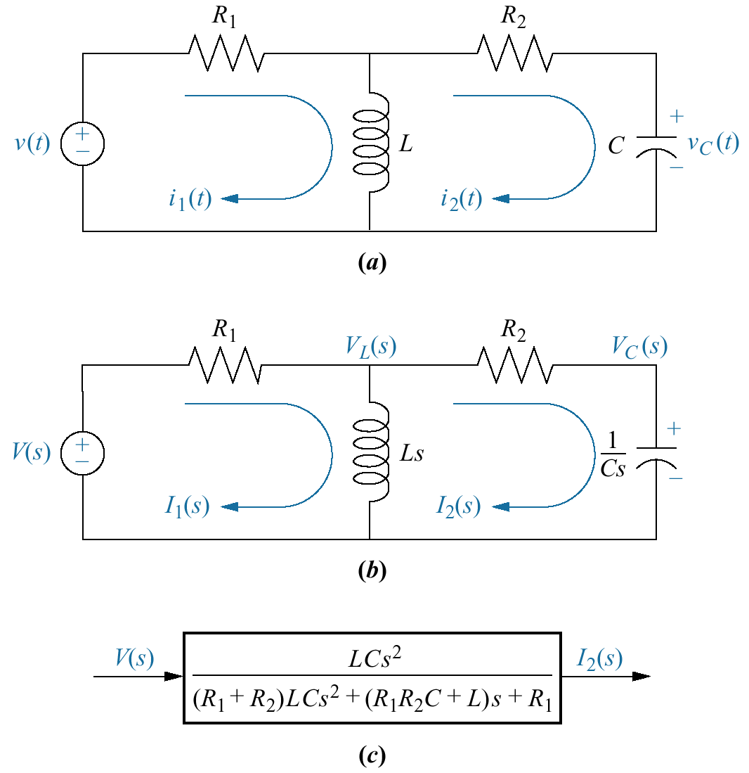
Example: Write the intego-differential equations and the transfer function of the following circuit
d
_{i1 R1} + L
( _{i1} − _{i 2} ) = v(t)
dt
₁ t
d
( _{i 2} − _{i1} ) + _{c} ∫ _{i2} dt = 0
_{i 2 R 2} + L
dt
0
Take Laplace Transform of both sides then find G(s) = I2(s)/V(s)

Slide 16
Nodal and Loop Analysis
Nodal and loop analysis is the structured way of applying physical laws and getting model equations
Node 1
Element
1
Loop 1
Element
2
Loop 2
Element
3
Node 2
16

Slide 17
Analysis of Electrical Systems
Nodal analysis based on Kirchhoff's current law
Loop or Mesh analysis based on Kirchhoff’s voltage law
Kirchhoff's Current Law (KCL)
At any node in an electrical circuit, the directed sum of currents flowing out of that node is equal to zero.
𝑖₁
−
Kirchhoff's Voltage Law (KVL)
In an electrical circuit, the directed sum of voltages around a closed loop is zero.
Node 1 𝑖₃
+
𝑖₂
At node 1,
𝑖₁ + 𝑖₂ + 𝑖₃ = 0
Element
3
Around loop 1,
𝑣₁ + 𝑣₂ = 0
𝑣
Element
1
Loop 1
Element
2
𝑣
1
2
+
−
17

Slide 18
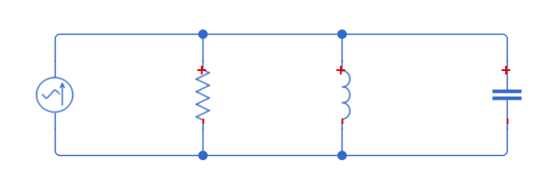
Nodal Analysis : Example
Node 1
𝑉
𝐼
𝑅
𝐼_{𝑅}
𝐿
𝐼_{𝐿}
𝐼_{𝐶}
𝐶
Applying KCL at node 1:
𝐼 = 𝐼_{𝑅} + 𝐼_{𝐿} + 𝐼_{𝑐}
𝑉 1 𝑑𝑉
𝐼 = _{𝑅} + _{𝐿} 𝑉𝑑𝑡 + 𝐶 _{𝑑𝑡}
𝑑𝜙
𝑑²𝜙 1 𝑑𝜙 𝜙
Substituting 𝑉 = :
𝑑𝑡
𝐼 = 𝐶 + +
𝑑𝑡 ² 𝑅 𝑑𝑡 𝐿
18

Slide 19
Loop or Mesh Analysis: Example
𝑅 𝐿
𝐼 𝑉_{𝑅} 𝑉_{𝐿}
𝑉
𝑉_{𝐶} 𝐶
Loop 1
Applying KVL around loop 1:
𝑉 = 𝑉_{𝑅} + 𝑉_{𝐿} + 𝑉_{𝑐}
𝑑𝐼 1
𝑉 = 𝐼𝑅 + 𝐿 _{𝑑𝑡} + _{𝐶} 𝐼𝑑𝑡
Substituting 𝐼 = :
𝑑𝑡
𝑑𝑞 𝑑²𝑞
𝑑𝑞 𝑞
𝑉 = 𝐿 + 𝑅 +
𝑑𝑡 ² 𝑑𝑡 𝐶
:
19

Slide 20
Mechanical Systems
Classification based on type of motion:
Translational systems having linear motion
Rotational systems having angular motion about a fixed axis
Translational | Rotational
Basic System Elements
Mass (𝑀) | Inertia (𝐽)
Damper (𝐵) | Damper (B)
Linear spring (𝐾) | Torsional spring (𝐾)
Basic System Variables
Force (𝐹) | Torque (𝑇)
Displacement (𝑥) | Angular displacement (𝜃)
Control systems
11

Slide 21

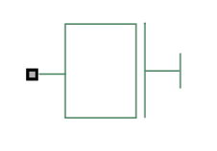

Mass Vs Inertia
Mass
Property of an element that stores the kinetic energy due to translational motion
When a force is acting on a body of mass 𝑀 causing displacement 𝑥, then:
Inertia
Property of an element that stores the kinetic energy due to rotational motion
When a torque is acting on a body of inertia J causing displacement 𝜃, then:
𝑑² 𝜃
𝑇 = 𝐽 = 𝐽dω/dt
𝑑𝑡²
𝑇
𝐹
𝑀
𝐽
𝑥, v
𝜃,ω
:
12

Slide 22
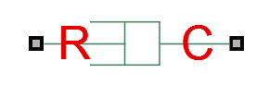
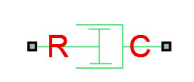
Damper
Damper is an element that generates force which acts opposite to the direction of motion, translational or rotational
Damper resists motion
Friction or dashpot are examples of dampers
Translational Rotational
𝐹
𝑥1,v1
𝐹
𝑥2,v2
𝑇
𝜃2
𝑇
𝜃1
𝐵
B
𝑑𝑥
𝐹 = 𝐵 = 𝐵∆v
=B(v2-v1)
𝑑𝜃
𝑇 = B _{𝑑𝑡} = B∆𝜃
𝑑𝑡
=B(𝜃2-𝜃1)
Note: R&C represent ports

Slide 23

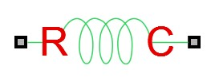
Linear Vs Torsional Spring
Linear Spring
Property of an element that stores the potential energy due to translational motion
When a spring of spring constant
𝐾 is applied a force 𝐹 causing an elastic displacement 𝑥, then:
𝐹 = 𝐾𝑥
𝐹
𝑥
𝐾
Torsional spring
Property of an element that stores the potential energy due to rotational motion
When a torsional spring of constant
𝐾 is applied a torque 𝑇 causing an angular displacement 𝜃, then:
𝑇 = 𝐾𝜃,
𝑇
𝜃
𝐾
T=K(𝜃1-𝜃2)
F=K(x1-x2)
:x1
:x2
: 𝜃1
:𝜃2
Note: R&C represent ports

Slide 24
Describing Differential Equations for Electrical and Electronic Elements

Slide 25
Mechanical Systems
Classification based on type of motion:
Translational systems having linear motion
Rotational systems having angular motion about a fixed axis
Translational | Rotational
Basic System Elements
Mass (𝑀) | Inertia (𝐽)
Damper (𝐵) | Damper (B)
Linear spring (𝐾) | Torsional spring (𝐾)
Basic System Variables
Force (𝐹) | Torque (𝑇)
Displacement (𝑥) | Angular displacement (𝜃)
Control systems
11

Slide 26
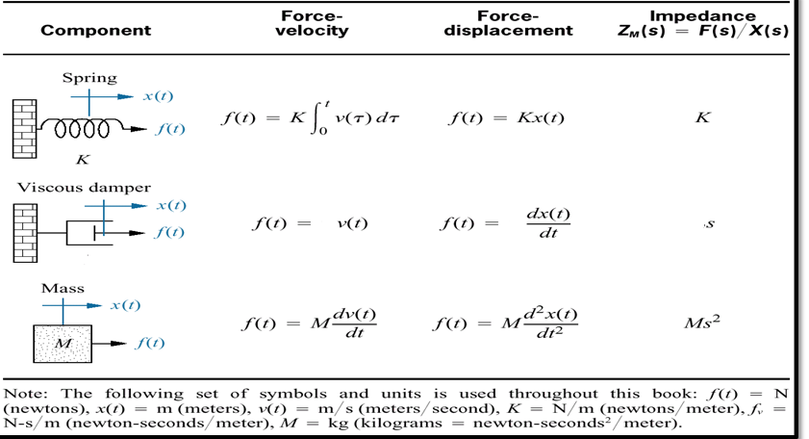
Describing Differential Equations for Translation Mechanical Elements
B
B
BS
B

Slide 27
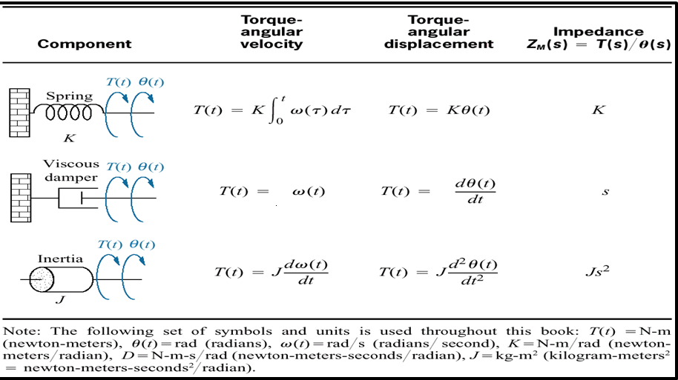
Describing Differential Equations for Rotational
B
B
B
B

Slide 28
Summary: Analogous Systems
Following table shows the analogue between the elements of mechanical and electrical systems:
Mechanical System |  | Electrical System
Translational | Rotational | F-V Analogy | F-I Analogy
Force (𝐹) | Torque (𝑇) | Voltage (𝑉) | Current (𝐼)
Mass (𝑀) | Inertia (𝐽) | Inductor (𝐿) | Capacitor (𝐶)
Friction (𝐵) | Friction (𝐷) | Resistor (𝑅) | Conductor (1/𝑅)
Linear spring (𝐾) | Torsional spring (𝐾) | Capacitor (1/𝐶) | Inductor (1/𝐿)
Displacement (𝑥) | Displacement (𝜃) | Charge (𝑞) | Flux (𝜙)
25

Slide 29
Nodal Analysis for Mechanical Systems
System structure should be modified to suit nodal analysis, without loss of system characteristics
Steps of nodal analysis are detailed by an example
15

Slide 30
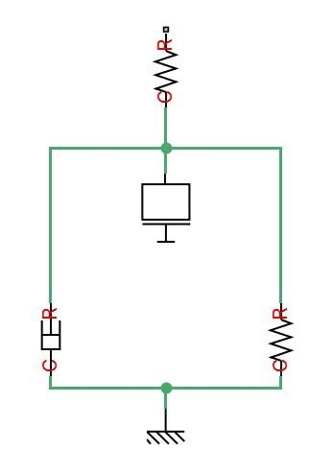
Nodal Analysis : Example
Node 1
𝐹
𝐾₁
Node 2
Step 1:
Number of nodes = 2
Hence, number of displacements = 2
𝑀
𝐵
𝐾₂
Reference
:

Slide 31
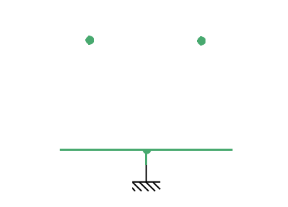
Nodal Analysis : Example
𝑥₁
𝑥₂
Step 2:
Displacement and reference nodes are
identified
F
𝐾₁
Node 2
Reference Node
𝑀
𝐵
𝐾₂
:

Slide 32
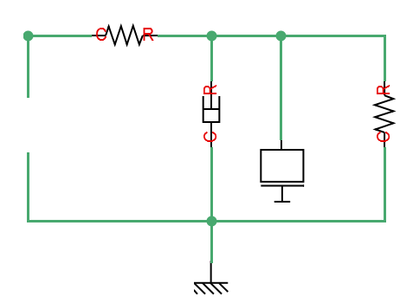
Nodal Analysis : Example
Step 3:
Connect mass 𝑀 between
node 𝑥₂ and reference node
𝑥₁
𝑥₂
𝐾₁
Step 4:
𝐾₂
Connect spring 𝐾₁ between
nodes 𝑥₁ and 𝑥₂
Connect spring 𝐾₂ between
𝑥₂ and reference node
𝐹
𝐵
𝑀
Step 5:
Reference Node
Connect the force 𝐹 between 𝑥₁ and reference node
:

Slide 33

Nodal Analysis : Example
Step 6:
𝑥
𝑥₂
Apply Newton’s 2nd law at node 𝑥₁:
𝐹 = 𝐾₁ 𝑥₁ − 𝑥₂ (1)
1
𝐾₁
𝐾₂
Apply Newton’s 2nd law at node 𝑥₂:
𝐹
𝐵
𝑀
Eq.1 and Eq.2 give the mathematical model of the given mechanical system
Reference Node
:

Slide 34


Nodal Analysis : Example
𝑥
𝑥₂
Step 6:
𝐾₁
Apply Newton’s 2nd law at node 𝑥₁:
𝐹 = 𝐾₁ 𝑥₁ − 𝑥₂ (1)
1
𝐵
𝐾₂
𝐹
𝑀
Apply Newton’s 2nd law at node 𝑥₂:
Reference Node
Eq.1 and Eq.2 give the mathematical model of the given mechanical system
:

Slide 35
Summary: Analogous Systems
Following table shows the analogue between the elements of mechanical and electrical systems:
Mechanical System |  | Electrical System
Translational | Rotational | F-V Analogy | F-I Analogy
Force (𝐹) | Torque (𝑇) | Voltage (𝑉) | Current (𝐼)
Mass (𝑀) | Inertia (𝐽) | Inductor (𝐿) | Capacitor (𝐶)
Friction (𝐵) | Friction (𝐷) | Resistor (𝑅) | Conductor (1/𝑅)
Linear spring (𝐾) | Torsional spring (𝐾) | Capacitor (1/𝐶) | Inductor (1/𝐿)
Displacement (𝑥) | Displacement (𝜃) | Charge (𝑞) | Flux (𝜙)
25

Slide 36



Example: Write the differential equations and the transfer function of the Spring Mass Damping System shown
x(t),v(t)
Taking Laplace TF
K
M
f (t)
transfer function
B
V (s)
F (s)
s
differential equation
=
(Ms + Bs + K )
2
d ² x(t) dx(t)
B + Kx(t) = f (t)
M
dt ² dt

Slide 37




Example: Write the differential equations and the transfer function of the Spring Mass Damping System shown
Taking Laplace TF
x(t),v(t)
K
M
f (t)
transfer function
B
differential equation
If, L=C=R=M=B=K=1, than
Electrical equivalent (F-V)

Slide 38



Example: Write the differential equations and the transfer function of the Spring Mass Damping System shown
Taking Laplace TF
x(t),v(t)
K
M
f (t)
transfer function
B
differential equation
If, L=C=R=M=B=K=1, than
Electrical equivalent (F-V)

Slide 39


Example: Write the differential equations and the transfer function of the Spring Mass Damping System shown
x(t),v(t)
K
M
f (t)
B
differential equation
Electrical equivalent (F-V)
Electrical equivalent (F-I)

Slide 40
Summary: Steps of Nodal Analysis
Identify number of nodes which is equal to number of displacements
Take a reference node independent of other nodes (displacement nodes)
Connect all mass / inertia elements between the relevant displacement node and the reference node irrespective of its position
Connect spring and damper elements between relevant nodes based on their position
Connect force or torque between the relevant displacement node and the reference node
At each of the displacement nodes, apply Newton’s laws of motion

Slide 41
Example: Write the differential equations to model the system shown
Output
B
Input
f (t)
x (t)
x (t)
1
K
2
M₁
2
M ₂
K₁
K₃
B
For the node x1
K₂ (x₁(t) – x₂(t)) + K₁x₁(t) + B d/dt (x₁(t) – x₂(t)) + M₁ d²x /dt² x₁(t) = f(t) For the Node x2
K₂ (x₂(t) – x₁(t)) + B d/dt (x₂(t) – x₁(t)) + K₃x₂(t) + M₂ d²x₂/dt² = 0
Find TF=X2(S)/F(S)

Slide 42
Example: Write the differential equations to model the system shown
Output
B
Input
f (t)
x (t)
x (t)
1
K
2
M₁
2
M ₂
K₁
K₃
B
For the node x1
K₂ (x₁(t) – x₂(t)) + K₁x₁(t) + B d/dt (x₁(t) – x₂(t)) + M₁ d²x /dt² x₁(t) = f(t) For the Node x2
K₂ (x₂(t) – x₁(t)) + B d/dt (x₂(t) – x₁(t)) + K₃x₂(t) + M₂ d²x₂/dt² = 0
Find TF=X2(S)/F(S)

Slide 43


Example: Write the differential equations to model the system shown
Output
B
Input
f (t)
x (t)
x (t)
1
K
2
M₁
2
M ₂
K₁
K₃
B
At Node x1
Find TF=X2(S)/F(S)
At Node x2

Slide 44


For the node x1
…(1) Electrical equivalent (F-V)
For the Node x2 …(2)
Electrical equivalent (F-V)
Electrical equivalent circuit
Force –voltage
Velocity-current
M - L
K - 1/C
B - R

Slide 45


For the node x1
…(1) Electrical equivalent (F-i)
For the Node
Electrical equivalent (F-i) …(2)
Electrical equivalent circuit
Force –current (f-i)
Velocity- voltage(v-e)
M - C
K - 1/L
B - 1/R

Slide 46
Analogous Systems
Mechanical systems can be represented using electrical elements
by the following analogies
Two types of analogies:
Force (Torque) - Voltage analogy (F-V analogy)
Force is analogous to voltage
Force (Torque) - Current Analogy (F-I analogy)
Force is analogous to current

Slide 47
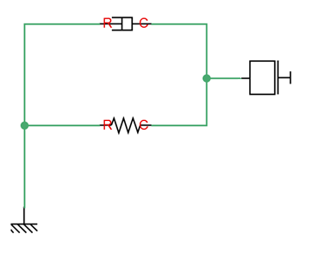


Mass-Spring-Damper (MSD) System
𝐹,T
𝐵
Based on Newton’s 2nd law,
𝐹 = 𝑀a+ 𝐵v+ 𝐾𝑥
𝑀
Similarly for a rotational
system,
𝑇 = 𝐽α + Bω+ 𝐾𝜃
𝐾
𝑥, 𝜃
Reference
:

Slide 48
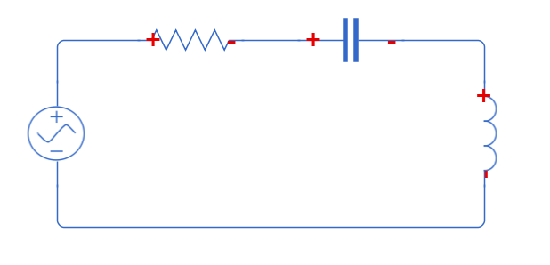


F-V Analogy of MSD System
𝑅
𝐶
𝐹
𝐵
𝑀
e
𝐿
𝐾
𝑥
𝐹 →e
v → i
𝑀 → 𝐿
𝐵 → 𝑅
𝐾 →1/C
𝑥 → 𝑞
Reference
Based on KVL around the loop,
Based on Newton’s 2nd law,
:

Slide 49
F-V Analogy of MSD System
𝐹
𝐵
𝑀
𝑅
𝐶
e
i
𝐿
𝐾
𝑥
Reference
𝐹 →e
v → i
𝑀 → 𝐿
𝐵 → 𝑅
𝐾 →1/C𝑥 → 𝑞
:

Slide 50
Examples
Fly wheel(rotating Mass)
Oppose rate of change of velocity
Inductance in filter
Oppose rate of change of current

Slide 51
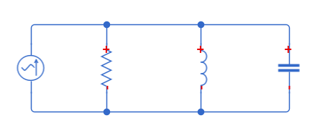

F-I Analogy of MSD System
𝐹
𝐵
𝑀
𝐼
𝑅
𝐿
e
𝐶
𝐾
v → e
𝑥
Reference
𝐹 → 𝐼
𝑀 → 𝐶
1
𝐵 → _{𝑅}
1
Based on Newton’s 2nd law,
Based on KVL around the loop,
𝐾 →
𝐿
𝑥 → 𝜙
:

Slide 52
Examples
= ^{𝑋 𝑠} = ¹ = ¹ (𝑀 = 𝐵 = 𝐾 = 1)
𝐹 𝑠 𝑀𝑠²+𝐵𝑠+𝐾 𝑠²+𝑠+1
= I(s) = ¹ = ¹ (L = R =C = 1)
𝐹 𝑠 LC𝑠²+RC𝑠+1 𝑠²+𝑠+1

Slide 53


Transformer Vs Gears
Transformer
Transmits electrical energy from one circuit to another through electromagnetic induction
Changes voltage level
Gears
A rotating machine to transmit torque
Changes speed and direction
of motion
𝑇₁ ₌ 𝑟₁ ₌ 𝜔₂
𝑉₁ 𝑁₁ 𝐼₂
𝑉
= _{𝑁} = _{𝐼}
𝑇₂ 𝑟₂ 𝜔₁
𝑇₁ , 𝑟₁, 𝜔₁
2 2 1
𝑇:Torque
𝑟:Radius
𝜔:Angular velocity
𝑁₁: 𝑁₂(Turns ratio)
𝑉₁
𝑉₂
𝑇₂, 𝑟₂, 𝜔₂
26

Slide 54
Overview
Summary :
Classification of physical systems
Electrical & Mechanical systems and their basic elements
Nodal & loop analysis
Analogous systems
Transformers & gears
27

Slide 55
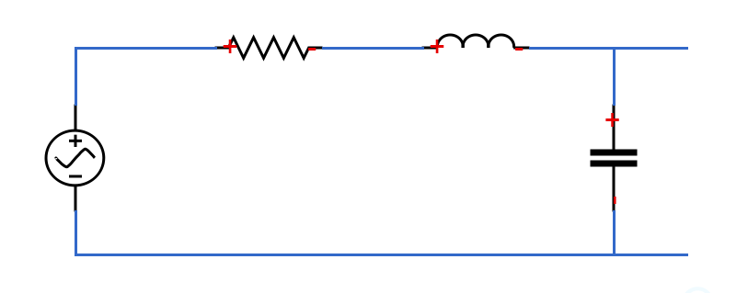
Motivation
How to find the response of a system for an given input signal?
E.g.
𝐿
𝐼(𝑡) 𝑅
Find 𝑉₀ 𝑡 for a
𝑉_{𝑖} (𝑡) 𝐶 𝑉₀(𝑡)
given signal 𝑉_{𝑖}(𝑡)
1
𝑉 (𝑡) = 𝑅𝐼(𝑡) + 𝐿 ^{𝑑𝐼}
_{𝑑𝑡} + _{𝐶} 𝐼𝑑𝑡
𝑖
1
𝑉₀(𝑡) = _{𝐶} 𝐼𝑑𝑡
:
3

Slide 56
Motivation
To find the time response, we need to solve ordinary differential
equations (integro-differential equations)
When model equations are transformed to 𝑠 − domain, they turn
out to be algebraic equations which are comparably easy to solve
The transformed model in 𝑠 − domain is called transfer function model
It is a model which is applicable for all kinds of input signals
56

Slide 57
Transfer Function : Example 1
𝐼(𝑡)
𝑅
𝐿
𝑉_{𝑖} (𝑡)
𝐶
𝑉_{𝑜}(𝑡)
1. Model Equations:
1
𝑉 (𝑡) = 𝑅𝐼(𝑡) + 𝐿 ^{𝑑𝐼}
_{𝑑𝑡} + _{𝐶} 𝐼𝑑𝑡
𝑖
1
𝑉₀(𝑡) = _{𝐶} 𝐼𝑑𝑡
8

Slide 58
Transfer Function : Example 1
Input and Output Variables:
– Input: 𝑉_{𝑖} 𝑡
– Output: 𝑉_{𝑜} 𝑡
Laplace Transform: (assuming initial conditions to be zero)
𝑉 (𝑠) = 𝑅𝐼(𝑠) + 𝑠𝐿𝐼(𝑠) + ¹ 𝐼(𝑠)
𝑖
𝑠𝐶
𝑉 (𝑠) = ¹ 𝐼(𝑠)
0
𝑠𝐶
4. Transfer Function:
1
𝑉 𝑠
¹ 𝐼(𝑠)
1
𝑠²𝐿𝐶 + 𝑠𝑅𝐶 + 1
₌ 0 ₌ 𝑠𝐶 ₌ 𝑠𝐶 ₌
𝐺 𝑠
𝑉_{𝑖} 𝑠
𝑅 + 𝑠𝐿 + ¹ 𝐼(𝑠) 𝑅 + 𝑠𝐿 + ¹
𝐶𝑠 𝐶𝑠

Slide 59
Transfer Function : Example 2
Find the transfer function of a system described by following
𝑑³𝑦 𝑑²𝑦 𝑑𝑦 𝑑𝑢
equation: _{𝑑𝑡3} + 10 _{𝑑𝑡2} − 5 _{𝑑𝑡} + 𝑦 = 10 _{𝑑𝑡} + 𝑢 with zero initial
conditions
Laplace Transform:
𝑌 𝑠 𝑠³ + 10𝑠² − 5𝑠 + 1 = 𝑈 𝑠
10𝑠 + 1
Transfer Function:
𝐺 𝑠
₌ 𝑌 𝑠
10𝑠 + 1
𝑠³ + 10𝑠² − 5𝑠 + 1
=
𝑈 𝑠

Slide 60

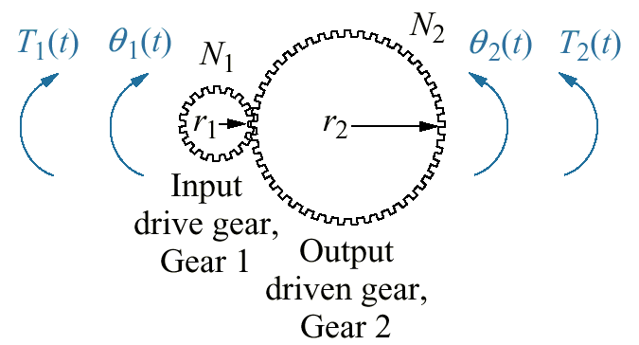

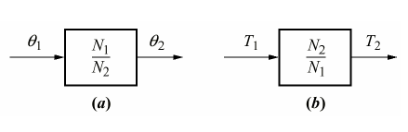
Describing Differential Equations for Rotational
Transfer Function for:
(a) Angular (b) Torque Displacement

Slide 61

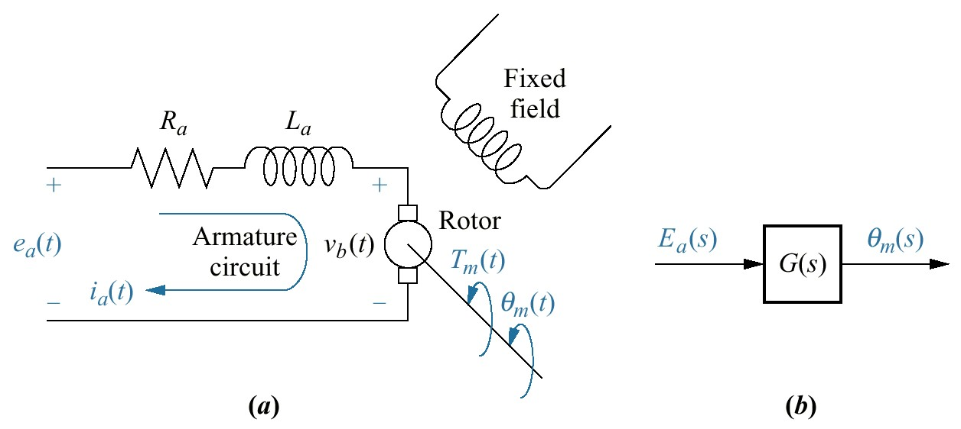

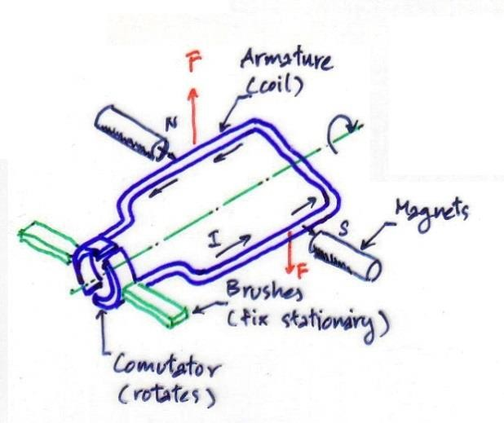

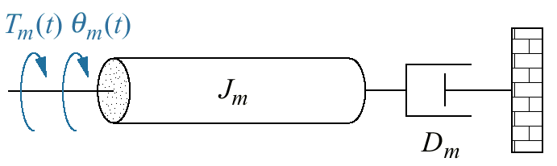
Describing Differential Equations for Electro Mechanical Elements
Mechanical Relation
DC Motor
T (s) = (J s² + D s)θ (s)
m m
m
m
Electrical Relation
T_{m} = Torque of the motor
K_{t} = motor torque constant
T_{m} (s) = K_{t} I_{a} (s)
Ia(s) = (Ea(s)-Vb(s))/(Ra+sLa)
dθ_{m} (t)
v = K
V_{b} = Back electomotive force
K_{b} = the constant back emf
b
b
dt
The Transfer Function is
θ_{m} (s) ₌
K_{t} R_{a} J_{m}
E_{a} (s) ⎡
1
K_{t} K_{b}
⎤
s⎢s + _{J}
(D_{m} +
)⎥
⎣
R
a ⎦
m

Slide 62




Properties of Transfer Function
Transfer function of a system is independent of the magnitude and nature of input
Using the transfer function, the response can be studied for various
inputs to understand the nature of the system
Transfer function does not provide any information concerning the physical structure of the system i.e., two different physical systems can have the same transfer function
E.g. MSD system : 𝐺 𝑠
= ^{𝑋 𝑠} = ¹ = ¹ (𝑀 = 𝐵 = 𝐾 = 1)
𝐹 𝑠 𝑀𝑠²+𝐵𝑠+𝐾 𝑠²+𝑠+1
₌ 𝑉₀ 𝑠
1 1
Series RLC circuit : 𝐺 𝑠
= = (𝑅 = 𝐿 = 𝐶 = 1)
𝑉_{𝑖} 𝑠
𝑠²𝐿𝐶+𝑠𝑅𝐶+1
𝑠²+𝑠+1

Slide 63
Transfer Function : General Form
General form of transfer function of a system:
𝑌 𝑠 𝑏₀𝑠^{𝑚} + 𝑏₁𝑆^{𝑚−1} + ⋯ + 𝑏_{𝑚−1}𝑠 + 𝑏_{𝑚}
⁼ 𝑈 𝑠 ⁼ 𝑎₀𝑠^{𝑛} + 𝑎₁𝑠^{𝑛−1} + ⋯ + 𝑎_{𝑛−1}𝑠 + 𝑎_{𝑛}
𝐺 𝑠
₌ 𝐾′ 𝑠 − 𝑧₁ 𝑠 − 𝑧₂ … 𝑠 − 𝑧_{𝑚}
𝑠 − 𝑝₁ 𝑠 − 𝑝₂ … 𝑠 − 𝑝_{𝑛}
𝑛: Order of the system
𝐾: System gain or Gain factor – A proportional value that relates the magnitude of the input to that of the output signal at steady state
𝑧₁, 𝑧₂, … , 𝑧_{𝑚}: Zeros of the system
𝑝₁, 𝑝₂, … , 𝑝_{𝑛}: Poles of the system
𝑛 ≥ 𝑚 because the system becomes non-causal and is not physically realizable if 𝑛 < 𝑚

Slide 64
Poles and Zeros
Poles:
Roots of the denominator polynomial of the transfer function
Values of 𝑠 at which the transfer function becomes unbounded
lim 𝐺 𝑠 = ∞
𝑠→𝑝_{𝑖}
Zeros:
Roots of the numerator polynomial of the transfer function
Values of 𝑠 at which the transfer function vanishes
lim 𝐺 𝑠 = 0
𝑠→𝑧_{𝑖}
Poles and zeros together with the system gain 𝐾 characterise the input- output system dynamics

Slide 65
Gain, Poles and Zeros : Example
Find the system gain, poles and zeros of the system with following transfer
function: _{𝑠3+3𝑠2+7𝑠+5}
6𝑠+12
𝐺 𝑠 =
6𝑠+12
𝑠³+3𝑠²+7𝑠+5
System DC gain : 𝐾 = ¹²
5
Zeros: 𝑠 + 2 = 0 ⟹ 𝑠 =- 2 ⇒ 𝑧₁ = -2
Poles: 𝑠³ + 3𝑠² + 7𝑠 + 5 = 0 ⟹ 𝑠 = −1, −1 + 2𝑗, −1 − 2𝑗
⟹ 𝑝₁ = −1, 𝑝₂ = −1 + 2𝑗, 𝑝₃ = −1 − 2𝑗
Note: Poles and zeros are purely real or appear in complex conjugates
(𝑎 ∓ 𝑗𝑏) because all the coefficients of transfer function are real

Slide 66
Summary :
Review of Laplace and Inverse Laplace transforms
Transfer Function and its properties
Block diagram representation of systems
Loading effect on transfer functions

